Slide 1

Data Science Project- P347 Study & Forecasting of Crude oil Prices
Submission date:
27-02-2024
Group-3:
Rajesh Kumar Dhuriya
Ashwini
Prashant Bagal
Kaushalraj Parmar
Vaishnavi Dipak Patil
Kasmi Sailaja
Neenu v Santhosh
Arjun cc

Slide 2
Contents:
Sr. No. | Content
1 | Background
2 | Step-1: Exploratory Data Analysis
3 | Step-2: Prediction models & performance comparison
4 | Step-2: Prediction models & performance comparison - ARIMA
5 | Step-2: Prediction models & performance comparison - SARIMA
6 | Step-2: Prediction models & performance comparison -Sequence Classification with LSTM Recurrent Neural Networks
7 | Step-2: Prediction models & performance comparison- All Model Summary
8 | Step-3: Forecasting with best model
9 | Step-4: Model deployment
10 | Conclusion & Next course of action

Slide 3
Background:
What is crude oil:
Types of Crude Oil
Crude oil is a type of fossil fuel which occurs naturally. It is unrefined petroleum oil and composed of hydrocarbon deposits & other organic materials
There are variety of over 100 types of crude oil, however out of them below two are most common:
West Texas Intermediate
It is a high-quality crude and is excellent for refining for maximizing Petrol.
It is light crude with an API gravity of 39.6 degrees.
The presence of 0.24 percent of Sulphur makes it a sweet crude.
2. Brent
It is a combination of crude oil from 15 different oil fields in the Brent and North Sea areas.
It is a reasonably light and sweet crude oil with an API gravity of 38.3 degrees.
Comprises 0.37 percent of Sulphur.
It is ideal for making Motor Spirit (Petrol) and middle distillates.
What is crude oil price:
It refers to spot price of a barrel of crude oil (119.2 ltr). It is reference price for buyer & seller and some of the references are:
West Texas Intermediate (WTI) | Indian Basket
Brent ICE | Urals oil
Dubai Crude | Isthmus
OPEC Reference Basket | Bonny Light
Tapis Crude | Western Canadian Select (WCS)
Major Factors affecting crude oil price:
The price of crude oil differs due to its grade. Below are major factors which affect change of oil price in India:
Specific gravity or API- Expensive if API Higher
Sulphur content- Expensive if low Sulphur content
Its location-proximity to tide water or refineries. Heavier, sour crude oil lacking in tide water access like WCS are less expensive than sweeter oil like WTI.

Slide 4
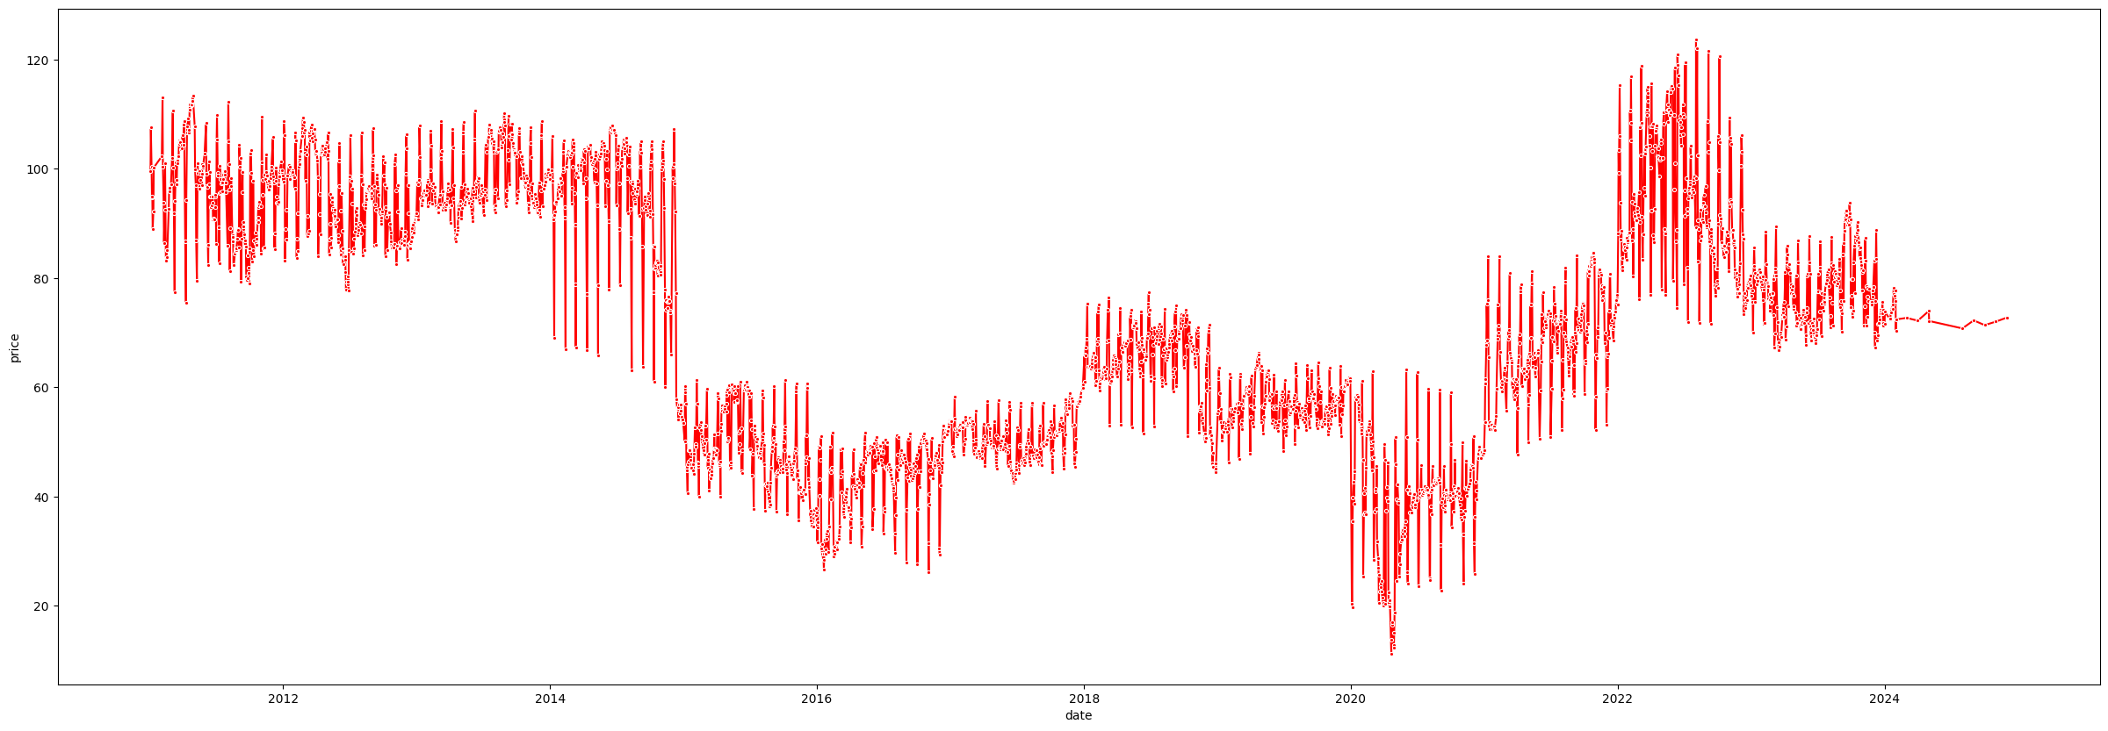
Step-1: Exploratory Data Analysis (1/3)
Data Selection
Visualization of macrotrend data
Data collected from macrotrends (https://www.macrotrends.net/1369/crude-oil-price-history-chart)
EuropeanBrent as provided in curriculum
1
Brief
Macrotrend data was analyzed.
Noted Major findings.
Collected Insights on finding from authentic sources.
Then, Europeanbrent data utilized for further observation.
It was noted macrotrend data is subset of European brent only.
Collected insights for remaining durations.
Converted day wise data to month wise data
Developed prediction models & deployment on month wise sample.
3
4
2
Observations & Insights
Oil prices were on peak (USD 118) in June 2022 due to decreased inventory of crude oil in second quarter of year & the low inventory was due to Russia-Ukraine war in first quarter of the year
Oil prices dropped (USD 20) in Apr-2020 due low demand due to COVID-19.
Major change in Mar 2015 due to supply factor. In this duration US supply was in boom which reduced oil prices by 43% globally (From USD 93.4 to USD 53). Boom in supply was due to advancement in drilling technologies & allowing free export of crude oil
Major Increase in Mar 2018 due to decrease in US economy & weak dollar. This increased the demand of oil & in turn increase in price by 32% (from USD 48.4 to USD 63.7). Weak dollar was due to fiscal stimulus, political crises in Europe etc.

Slide 5
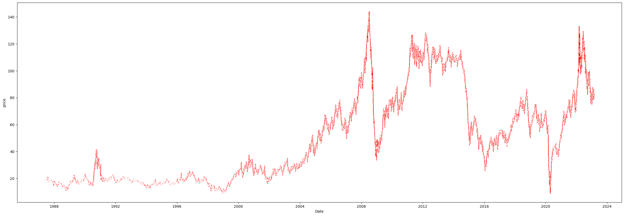
Step-1: Exploratory Data Analysis (2/3)
Visualization of Europeanbrent data
2
1
3
Observation & Insights
Observations same as macrotrends data for period 2011 to 2023.
From 2004 to 2008 oil prices continued to rise due to rising in demand & not meeting the demand by suppliers. in This period worlds dependency was only on OPECs (organization of petroleum exporting countries). Majorly Due to lack of technology OPECs were not able to meet the demand. Other reasons were political issues which lowered oil production & severe storm which damaged infrastructure & supply of oil in OPEC countries.
After reaching peak in Jul-2008, oil prices again when to lowest peak of 33.73 USD/barrel due to U.S. started producing shale gas(Shale gas refers to natural gas that is trapped within shale formations. Shales are fine-grained sedimentary rocks that can be rich resources of petroleum and natural gas). Due to the production America stopped importing petroleum from the OPEC (Organization of the Petroleum Exporting Countries), this increased the supply by approximately 40% and demand being the same the prices started to drop
Post Dec 2008, oil prices continued to increase till 2011 purely due to increase in demand.

Slide 6
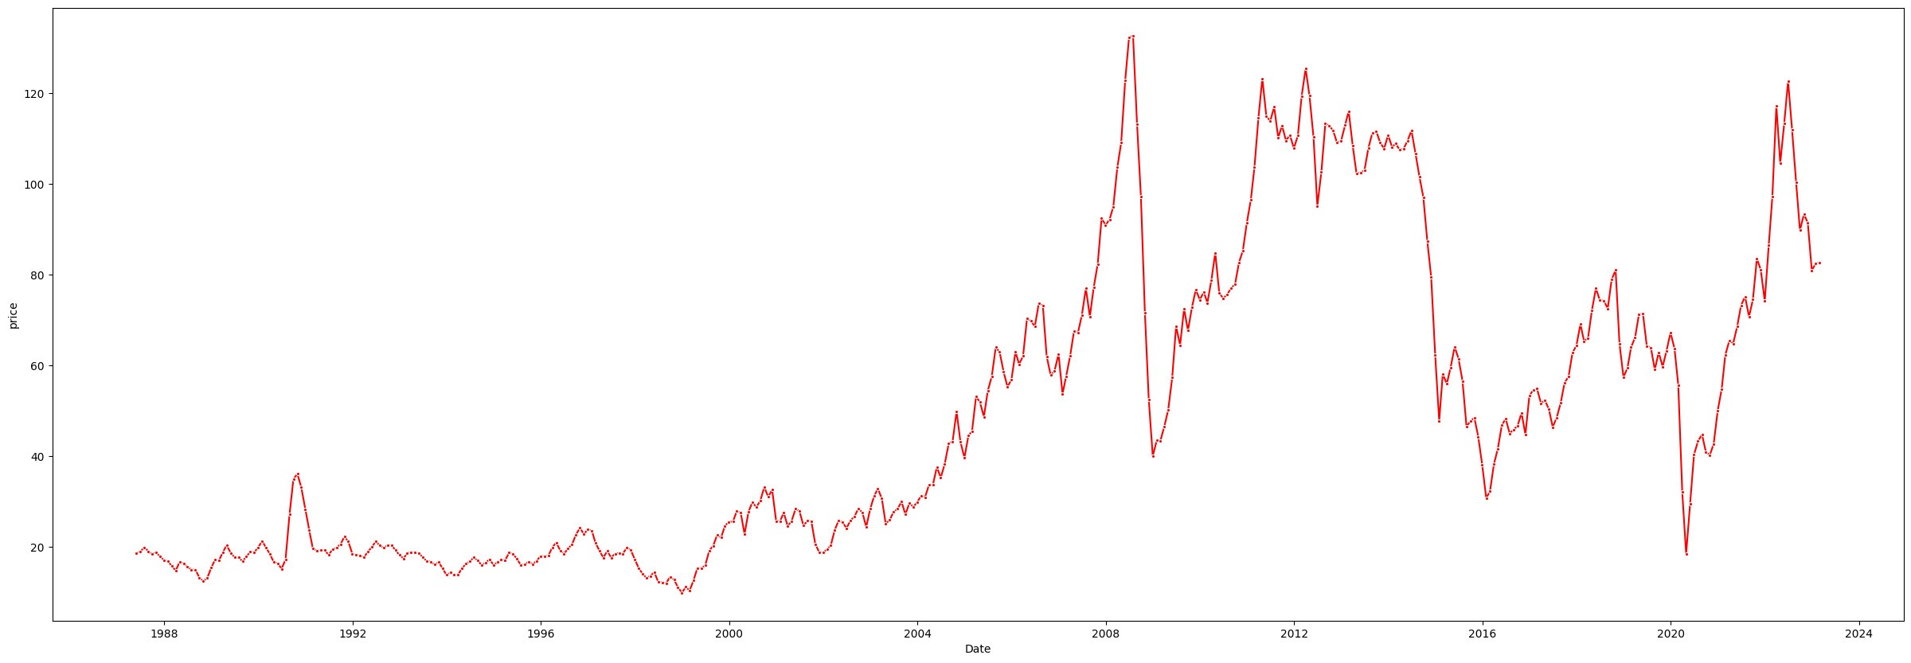
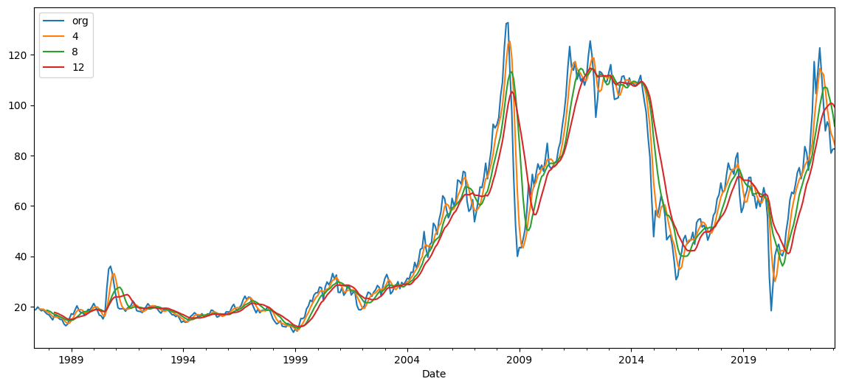
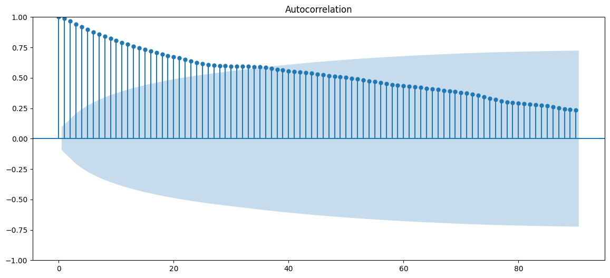
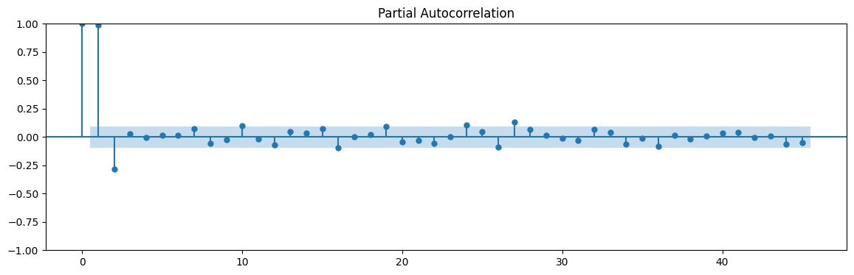
Step-1: Exploratory Data Analysis (3/3)
Conversion from Day wise to Month wise sample
Rolling mean at step of 4, 8 & 12
Autocorrelation
Partial Autocorrelation
highest correlation at lag 1 & 2
Reducing correlation as lag Increasing
No significant correlation at higher lag
Both ACF & PACF show best correlation at lag of 1 which is obvious in case of crude oil price & there is no correlation in seasonal data.
Rolling mean shows as moving average is for higher duration it is deviation more from original data.

Slide 7
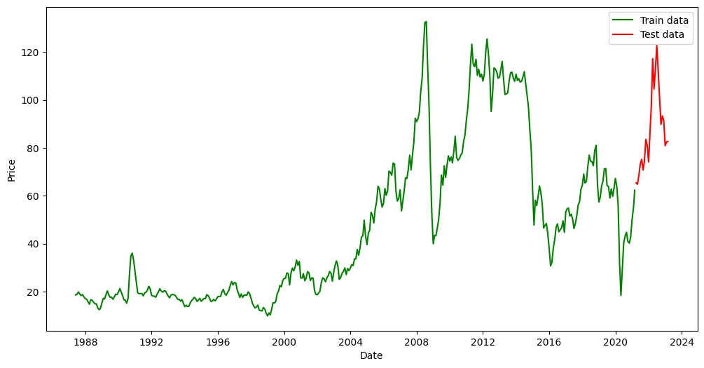
Step-2: Prediction models & performance comparison(1/6)
Models used for Prediction
Split of Train & Test dataset
Sr. No. | Model Name
1 | Simple exponential smoothing
2 | Double exponential smoothing
3 | Triple exponential smoothing with Additive Trend & Seasonal
4 | Triple exponential smoothing with Additive Trend & Multiplicative Seasonal
5 | Triple exponential smoothing with Multiplicative Trend & Additive Seasonal
6 | Triple exponential smoothing with Multiplicative Trend & Seasonality
7 | Autoregressive Integrated Moving Averages (ARIMA)
8 | Seasonal Auto Regressive Integrated Moving Average (SARIMA)
9 | Sequence Classification with LSTM Recurrent Neural Networks
First dataset was split into 80% Train & 20% test but performance of models was not observed satisfactory.
Then, latest 2 years data (5%) was considered as test while balance data as train (95%).
On above ratio all models were run & performance was tested.

Slide 8
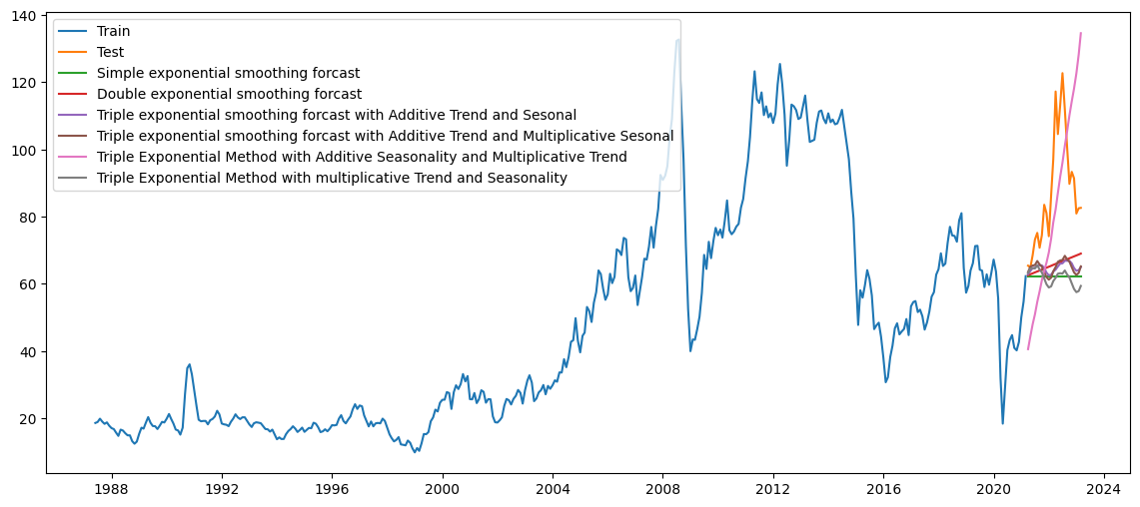
Step-2: Prediction models & performance comparison(2/6)
Model performance & summary
Simple exponential & double exponential were not able to capture seasonality & were far away from original data.
All triple exponential models were able to capture seasonality other than variant “Additive seasonality & multiplicative trend”.
However, all the models were observed far behind the original data trend.

Slide 9
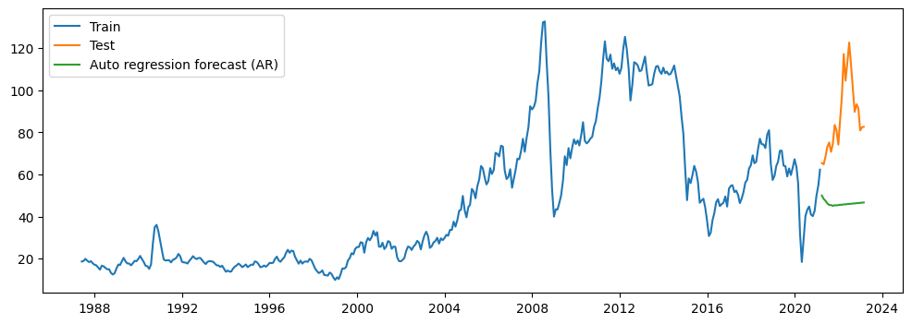
Step-2: Prediction models & performance comparison(3/6)
ARIMA Model performance & summary
ARIMA model also performed poor, it is not able to capture seasonality & showing almost flat trend.

Slide 10
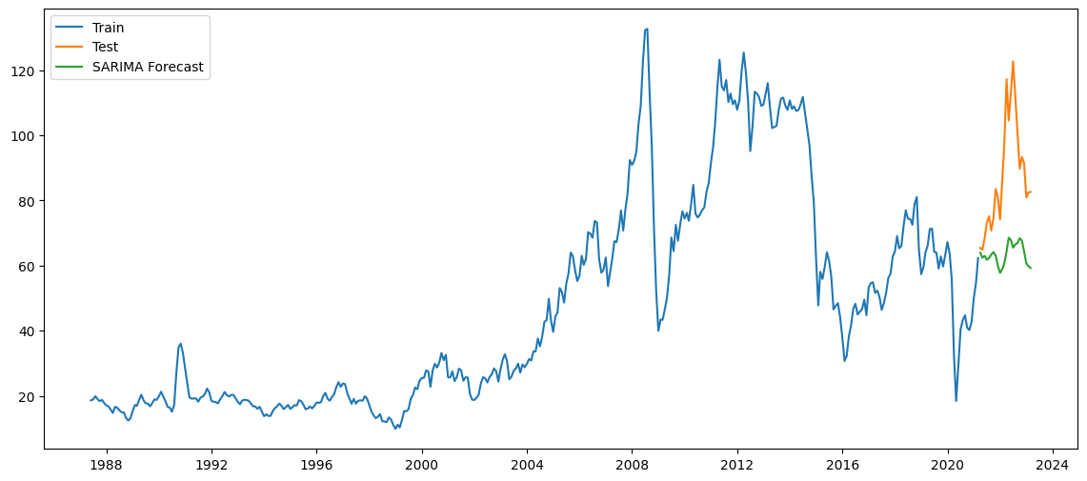
Step-2: Prediction models & performance comparison(4/6)
SARIMA Model performance & summary
SARIMA model performed better than ARIMA.
It is able to capture seasonality & trend.
But in terms of value its far behind actual dataset.

Slide 11
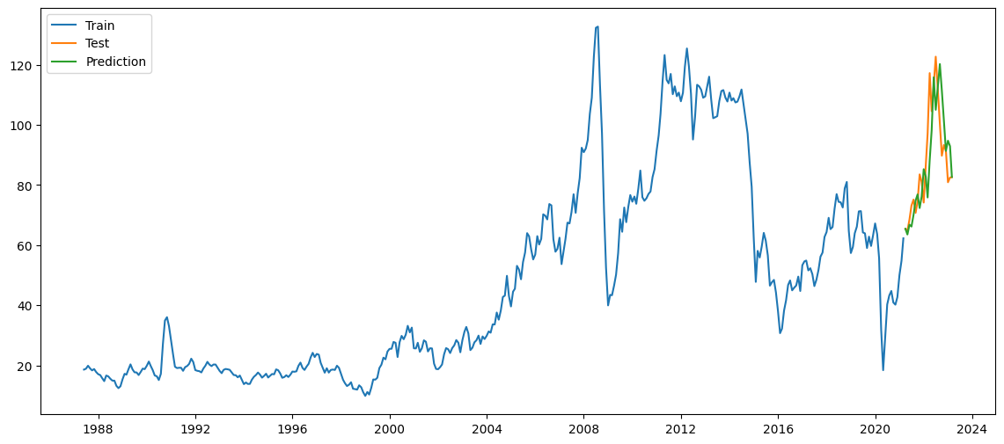
Step-2: Prediction models & performance comparison(5/6)
LSTM Model performance & summary
LTSM model has performed best as seen in graph.
It is able to capture seasonality & trend.
Also, in terms of value its very close to actual dataset.

Slide 12
Step-2: Prediction models & performance comparison(6/6)
All Model performance & summary
Sr. No. | Model Name | RMSE
1 | Simple exponential smoothing | 30.30
2 | Double exponential smoothing | 26.86
3 | Triple exponential smoothing with Additive Trend & Seasonal | 27.89
4 | Triple exponential smoothing with Additive Trend & Multiplicative Seasonal | 24.86
5 | Triple exponential smoothing with Multiplicative Trend & Additive Seasonal | 27.73
6 | Triple exponential smoothing with Multiplicative Trend & Seasonality | 30.85
7 | Autoregressive Integrated Moving Averages (ARIMA) | 44.80
8 | Seasonal Auto Regressive Integrated Moving Average (SARIMA) | 28.63
9 | Sequence Classification with LSTM Recurrent Neural Networks | 8.20
From above table its clear LSTM model has performed best & hence it should be utilized further for forecasting.

Slide 13
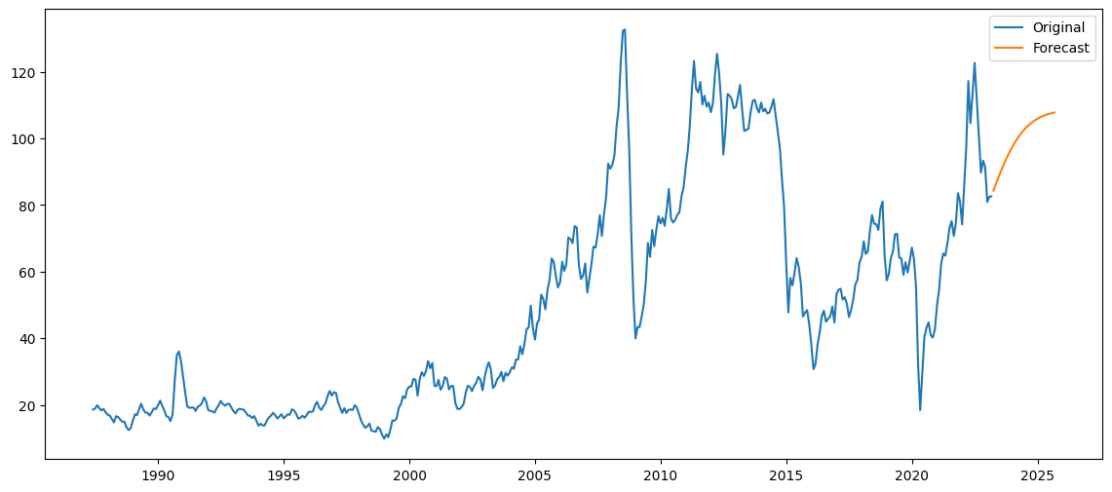
Step-3: Forecasting with best model
Forecast using LSTM Model
LTSM model was trained for complete dataset & next 2.5 years forecast was generated as below:
Forecast results:
Date | Price
2023-03-31 | 84.333895
2023-04-30 | 86.028581
2023-05-31 | 87.682797
2023-06-30 | 89.287414
2023-07-31 | 90.834186
2023-08-31 | 92.315911
2023-09-30 | 93.726649
2023-10-31 | 95.061756
2023-11-30 | 96.317950
2023-12-31 | 97.493327
2024-01-31 | 98.587264
2024-02-29 | 99.600274
2024-03-31 | 100.533910
2024-04-30 | 101.390604
2024-05-31 | 102.173461
2024-06-30 | 102.886137
2024-07-31 | 103.532667
2024-08-31 | 104.117309
2024-09-30 | 104.644456
2024-10-31 | 105.118496
2024-11-30 | 105.543774
2024-12-31 | 105.924486
2025-01-31 | 106.264639
2025-02-28 | 106.568028
2025-03-31 | 106.838197
2025-04-30 | 107.078444
2025-05-31 | 107.291823
2025-06-30 | 107.481131
2025-07-31 | 107.648919
2025-08-31 | 107.797507

Slide 14
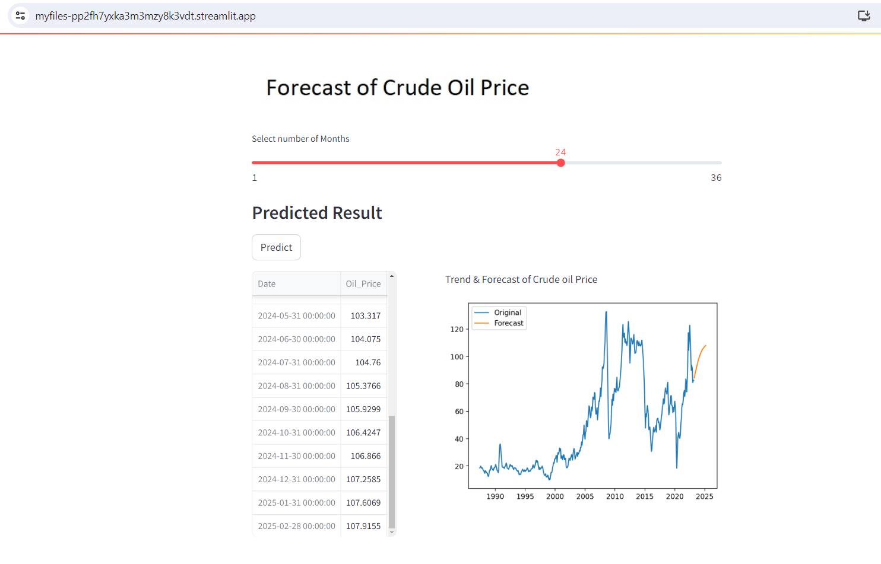
Step-4: Model deployment
Forecast LSTM Model deployment
Finally, LTSM model was deployed using streamlit library & below are results as per user input (24 in below case).
Link of deployed app at public space: https://myfiles-pp2fh7yxka3m3mzy8k3vdt.streamlit.app/

Slide 15
Conclusion & Next course of action
Conclusion
9 different models were tested for performance on test data set.
Out of these SARIMA & LSTM were observed to have good performance.
Based on least RMSE value, it was concluded LSTM model had performed best & far better than SARIMA.
However, LSTM has RMSE of 8, still there is scope of improvement & develop model more accurate.
Next course of action
Explore more forecasting models to have better accuracy.
Extract petroleum oil prices for same period. Correlate petrol prices to crude oil prices & utilize same model to forecast

Slide 16
Thank You
Project Participants:
Name | E-Mail | Contact
Rajesh Kumar Dhuriya | er.rajeshkumar123@gmail.com | 8003307859
Ashwini | ashwini.bs19@gmail.com | 9916043172
Prashant Bagal. | prashantbagal53@gmail.com | 7887660180
Kaushalraj Parmar | kaushalrajparmar2710@gmail.com | 8156049175
kasmi Sailaja | kasmisailaja96@gmail.com | 9912347677
Vaishnavi Dipak Patil | vaishnavipatil1405@gmail.com | 9075595627
Neenu v Santhosh | neenumol1807@gmail.com | 8606680430
Arjun cc | arjuncc12345@gmail.com | 7994005775

